Slide 1


School of Computer Science & IT Department of BCA
INTRODUCTION TO LINUX(20BCA1C06)
MODULE 1: INTRODUCTION TO LINUX COMMANDS
Faculty : Dr. Ananta Ojha

Slide 2
Session -2
History of UNIX
Features and Benefits
Versions of UNIX
Features of UNIX File

Slide 3
History of UNIX
MULTICS Project (Mid 1960s)
General Electric, Massachusetts Institute of Technology and AT&T's Bell Laboratories jointly started a multiuser operating system project called MULTICS (Multiplexed Information and Computing Service).
MULTICS was used for a campus-wide information service by the MIT, serving thousands of academic and administrative users.
It was a mainframe timesharing operating system and an important influence on operating system development.
1969: The first version of UNIX was created by Ken Thompson at AT&T's Bell Labs. Initially it was called UNICS (Uniplexed Operating and Computing System) which was eventually shortened to UNIX.
1973: At Bell Labs, Ken Thompson teamed up with Dennis Ritchie (who wrote the first C compiler) and they rewrote the Unix kernel in C.
1974: A version of Unix known as the Fifth Edition was first licensed to universities.
1975, Ken Thompson on its sabbatical year with the University of California at Berkeley, where he and two graduate students, Bill Joy and Chuck Haley, wrote a version of Unix, which was distributed to students.

Slide 4
History of UNIX
1977: The Berkeley version of Unix is known as BSD (Berkeley Software Distribution) was released.
From BSD came the vi editor, C shell, virtual memory, Sendmail, and support for TCP/IP.
BSD descendants like FreeBSD, OpenBSD, NetBSD, DragonFly BSD and PC-BSD is still active today.
1978: AT&T released UNIX Seventh Edition that included the Bourne Shell for the first time.
The Seventh Edition, released in 1978, resulted two divergent branches of Unix development: AT&T UNIX and BSD UNIX.
1983: AT&T developed System V, a commercial version of UNIX.
System V was favored by commercial enterprises, which contrasted with BSD's strength in the academic arena.
1980’s : Many companies started developing their own Unix: IBM created AIX, Sun SunOS (later Solaris), HP HP-UX and about a dozen other companies did the same.
1987: AT&T with Sun Microsystems produced System V, revision 4 (SVR4), which incorporated elements of BSD and SunOS into System V.
Most commercial UNIX implementations are based on the SVR4 model.
1991: Linus Torvalds, a student at the University of Helsinki, Finland, wrote Linux for his 386 computer similar to MINIX (mini-UNIX) system.
1994: He released Version 1.0 of Linux Kernel and put the sources code online (Early form of Internet).
Many people embraced the combination of this kernel with the GNU tools to develop Linux versions, and the rest is the growth history of Linux.

Slide 5
Features and Benefits
Multiusers and Multitasking:
Powerful OS to handle multiple users and tasks with excellent security features to manage.
handles active and background processes efficiently
Portability:
The operating system is written in high-level language making it easier to read, understand, change and, therefore move to other machines with a minimum of code changes.
Customers can choose from a wide variety of hardware vendors without vendor-locked-in.
UNIX Shell:
Simple User-Interface called the shell that acts as a command interpreter.
It provides a programming capability for the users to interact with the OS.
Pipes and Filters:
Permit the user to create complex programs from simple programs.
UNIX Tools:
Provides large number of tools for additional tasks to perform, for example typesetting, email etc.

Slide 6
Versions of UNIX
Initially, two main versions: that started at AT&T (the System V versions), and another from the University of California at Berkeley (the BSD versions). Later, several versions started in 90s.
Solaris : From Sun Microsystems, originally called SunOS, based on UNIX System V version 2 and BSD version 4.3. Subsequently, due to the presentation of UNIX System V version 4 a new version was developed called Solaris.
AIX: The UNIX system version for IBM machines is AIX (Advanced Interactive eXecutive) and is based on System V version 3 and BSD 4.3. AIX runs on IBM Power Systems.
A/UX: A/UX is Apple Inc.'s implementation of the Unix operating system for some of their Apple Macintosh computers, the latest versions running on the Mac II, Quadra and Centris series of machines.
HP-UX: HP-UX is based on the UNIX System V Release 4 and was designed by HP for the RISC architecture of Motorola. It is a pure server operating system with high availability and flexible memory and security management.
SCO UNIX / OpenServer: The version of Santa Cruz Operation (SCO) is based on System V, designed for Intel platforms. Now owned by Xinuos and known as OpenServer. Today, OpenServer 10 is based on FreeBSD.
Linux: Started by Linus Torvalds, in the early 90s. At present it has spread enormously all over the world and there are millions of users, both individuals and companies that use a Linux operating system.

Slide 7
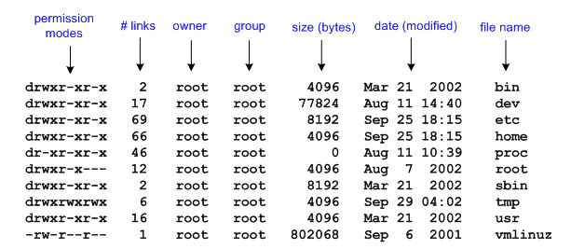
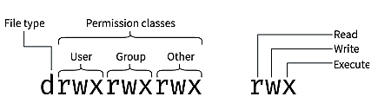
Features of Unix File
File: A UNIX file is a storehouse of information – a sequence of characters. A file is the smallest unit of storage in the Unix file system.
File attributes : Provide information relating to the file, but do not include the data contained within a file.
a file type (i.e. what kind of data is in the file); a file name (which may or may not include an extension); a physical file size; a file owner; file protection/privacy capability; file time stamp (time and date created/modified) etc.

Slide 8
File Types
The most notable feature of UNIX is that it considers everything as file. Unix divides file into three categories: ordinary files, directory files and device files.
Ordinary File:
This is the traditional definition of a file.
It contains streams of data stored on some permanent storage device like disk.
You can put any sequence of data, source program, executable program, images, video data etc.
Directory File:
A directory is used to organize groups of files.
It contains ordinary file, device files and other sub-directories.
It contains no data but keeps an account of all files and subdirectories it contains.
Device File:
Unix considers any device attached to the system to be a file.
Devices such as printer, tapes, hard drives, terminals etc. all are considered as files.

Slide 9
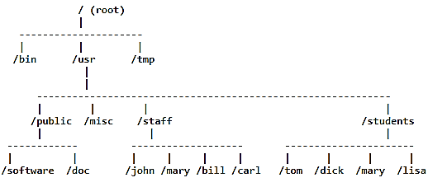
File System
The Unix file system is a method for logically organizing and storing large quantities of data such that it becomes easy to manage.
A file system consists of files, relationships to other files, as well as the attributes of each file.
Additionally, file systems provide tools which allow the manipulation of files.
All of the files in the UNIX file system are organized into a multi-level hierarchy structure (an inverted tree).
There is no single standard UNIX file structure. Most UNIX systems however, follow a general convention for files system organization at the highest level.
/(root) - The top level directory referred to as root.
Contains all files in the file system.
/bin - Executable files for standard UNIX utilities
/dev - Files that represent input/output devices
/etc - Miscellaneous and system administrative
files like password file and system start up files.
/lib - UNIX program libraries
/tmp - Temporary space used by programs or users.

Slide 10
Navigation
UNIX provides a simple mechanism called pathname for accessing a file.
UNIX allows you to move around the file system using the file pathnames.
A pathname consists of a sequence of directory names, separated by /’s.
A pathname can be absolute or relative.
With absolute file path, the pathname always begins from the root directory, complete and unambiguous. Absolute file path are sometimes referred to as fully qualified path names. Thus, absolute file specs always begin with /. For example: /etc/passwd/abc.txt
With relative file path, the pathname always is related to the user’s current position or location in the file system and does not start with root directory.

Slide 11

THANK YOU Any questions…?

